Slide 1
Behaviors
@roberthedgate - robert.hedgate@jayway.com

Slide 2
Annoying English
Watch out for the spelling.
Use the American spelling “behavior” not the British “behaviour”.
Both are correct but since MS is an American company they use “behavior”

Slide 3
What is a behavior
Encapsulate pieces of functionality into a reusable component
Emphasis on reusable
One can usually do it more easily in codebehind or direct in XAML
Keeps the MVVM pattern intact, no codebehind or ViewModel knowing what object is in use.

Slide 4
Two types of behaviors
Attached Behavior
Static
Can be used in Store Apps
Not blendable
Blend Behavior
Blendable
Can specify type
Not available in store Apps (is in NuGet)

Slide 5
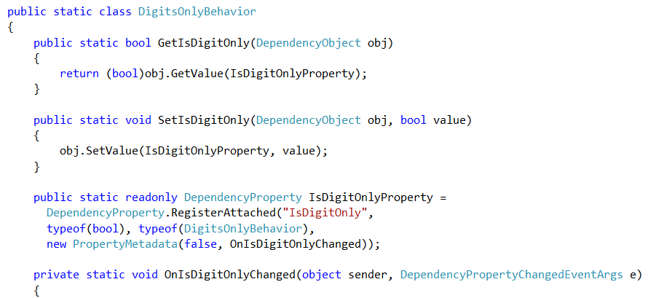
Attached Behavior
Notes:
RegisterAttached
Get
Set

Slide 6
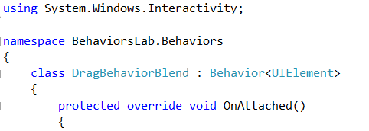
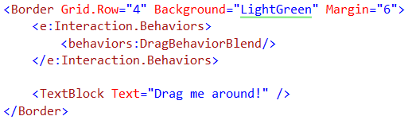
Blend Behavior
Notes:
Using System.Windows.Interactivity
OnAttached

Slide 7
Summary
Attached or Blend Behavior
Use either one
Use them for reusability
Helps keep MVVM pattern

Slide 8
Lab
Task 1
Make the drag text ”dragable”
Use both Attached and Blend Behavior
Task 2
Scroll in selected item when Select last item is clicked. (To simulate supporting MVVM)
Task 3
Make a drag and drop behavior

